Slide 1
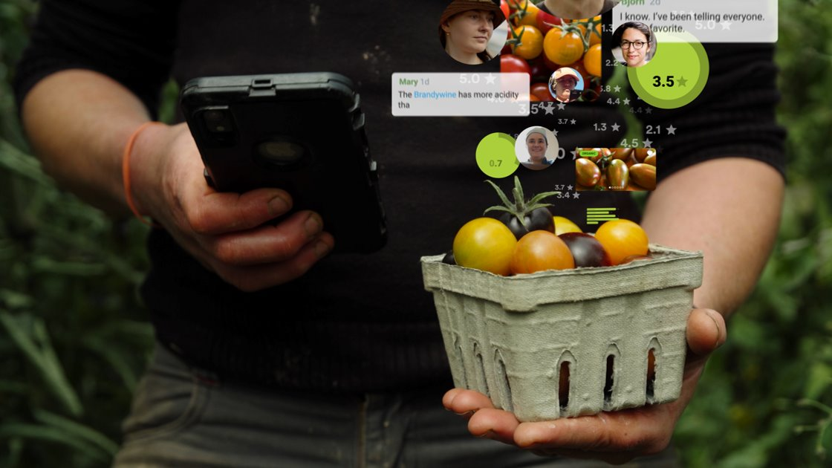

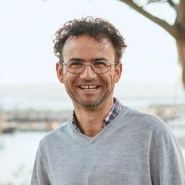
Nicolas Enjalbert
CEO &
Co-Founder
Community-Supported Germplasm Characterization
8.1.25
Notes:
To merge with slide 2
RV- Remi is a co-founder? When did that happen?
RV- it seems you have several SeedLinked tag lines. Do you want to stick with one? Every seed has a story? It is a little confusing to digest.

Slide 2
Background
SeedLinked started germplasm characterization in 2018 with SSE
In 2025: expansion
2018
2024
2025
In 2024 with USDA with one trial: Bean

Slide 3
Funding
ARS X: $100K
SSE: $8.5K
2026
2025
No NPGS secure funding

Slide 4
2025 Project goals
Improve characterization data collection
Many more traits and criteria collected
Refine approach and understand better KPI
Grower per accession ratio needed
Participation dynamic
Data collected per accessions threshold.
API integration

Slide 5
Trial design
Seed Source: 3 curators in USDA NPGS and SSE
15 crops-Trials
255 accessions
1500 growers (2.8 trial av)
Trials: 3,320
9,960 Plots
5 to 20 seeds
3 accessions per site (triadic)
Accessions repeated at least 25 times – 25 locations

Slide 6
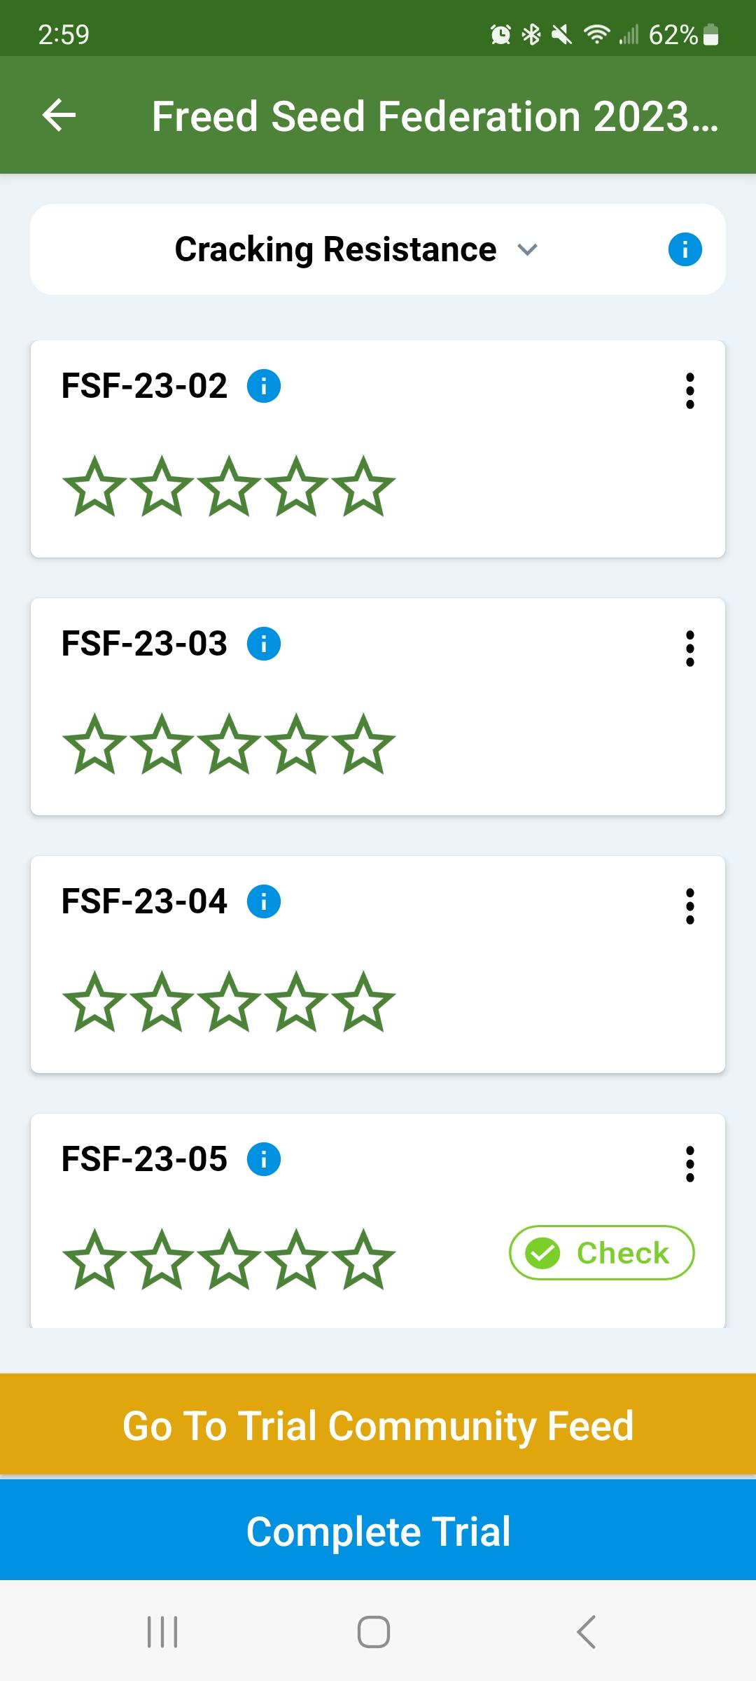
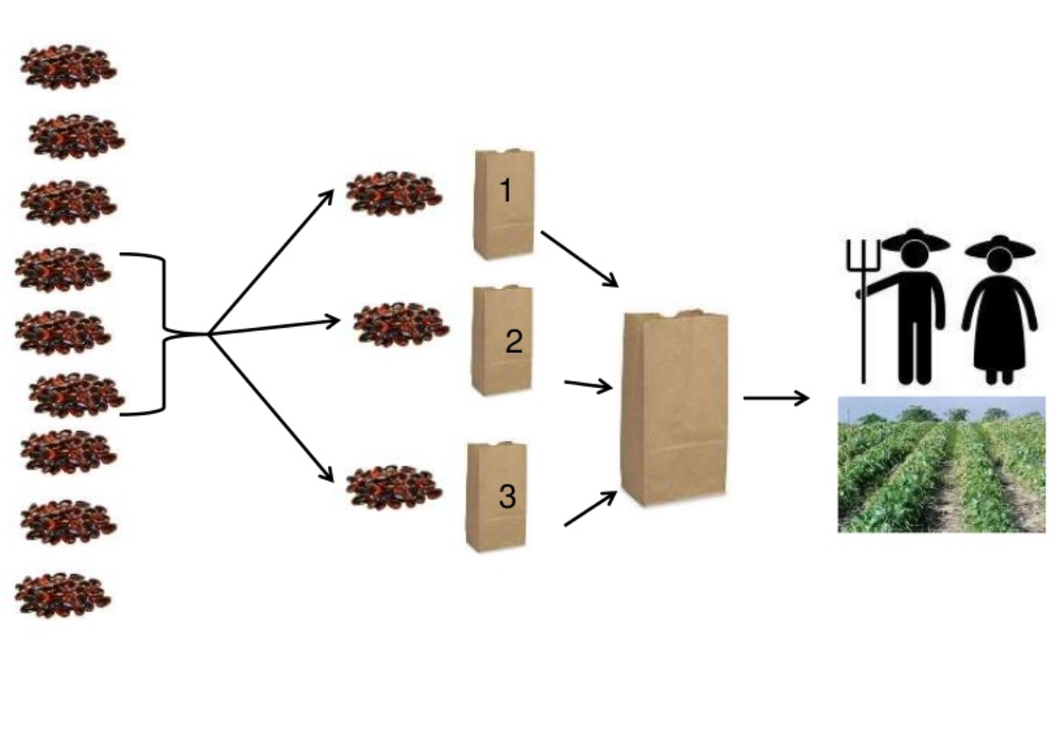
Novel statistic model: triadic
+ one fixe check

Slide 7




Data collection and interaction
TRACK
Innovate together
FEED
Connect & Interact
SEARCH
Explore and find

Slide 8
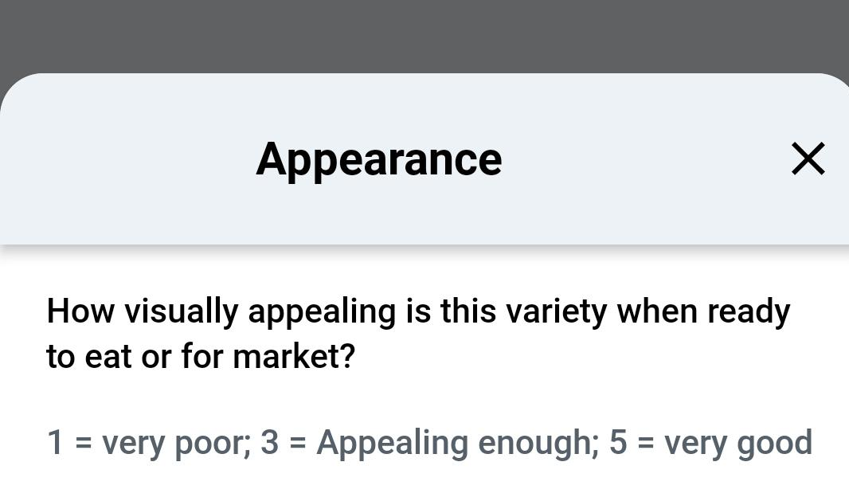
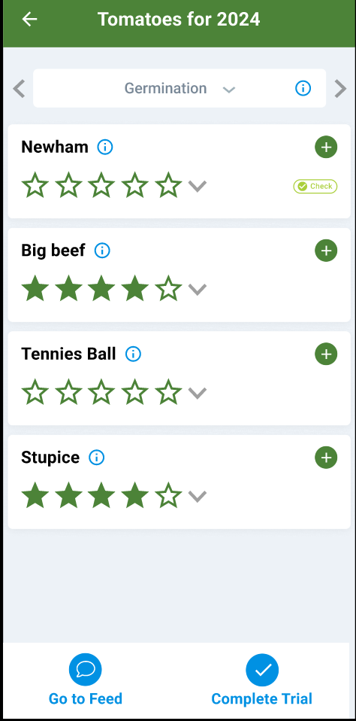
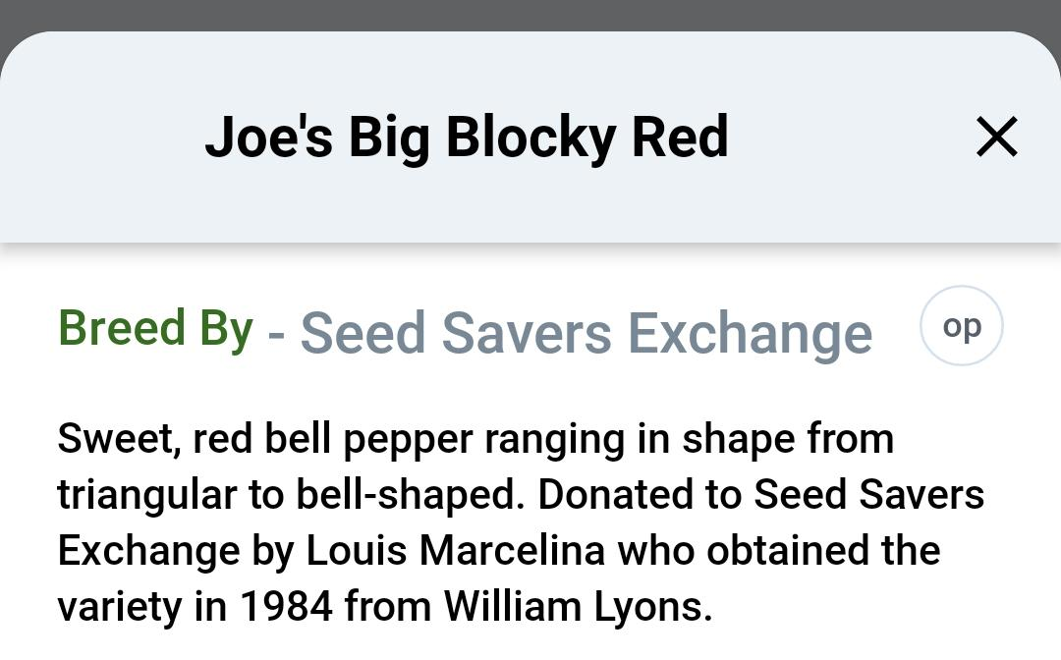
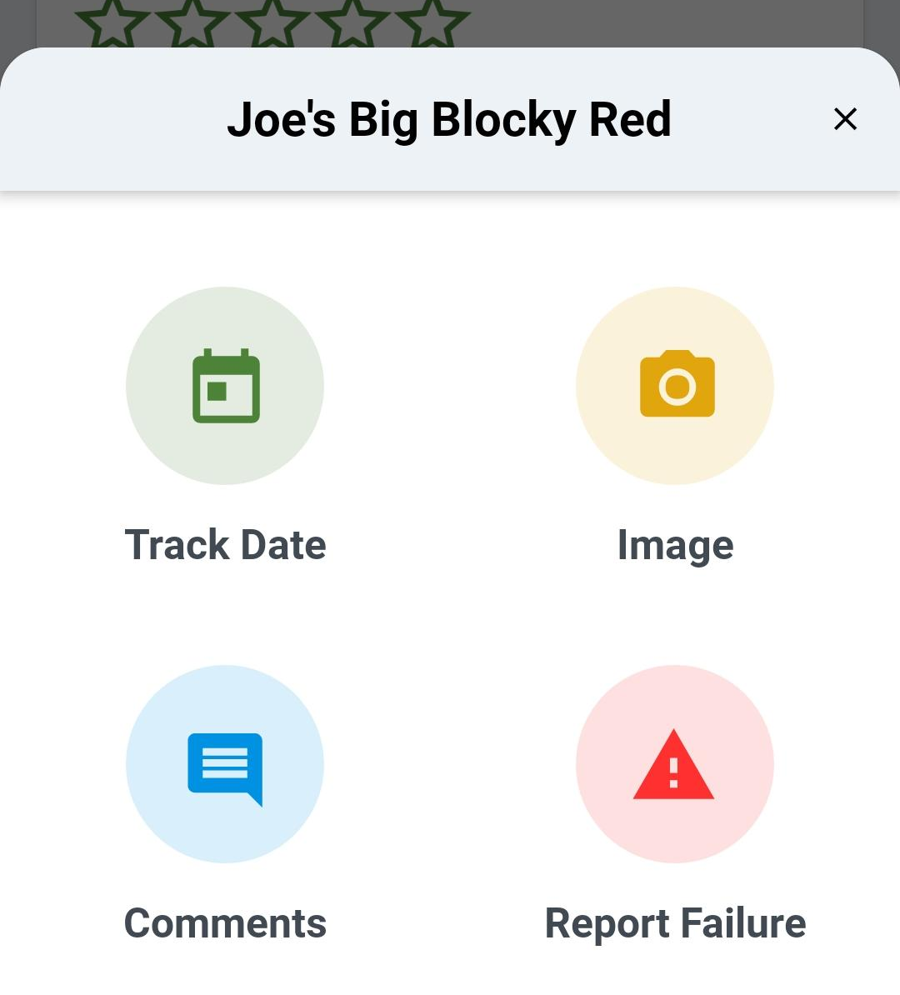
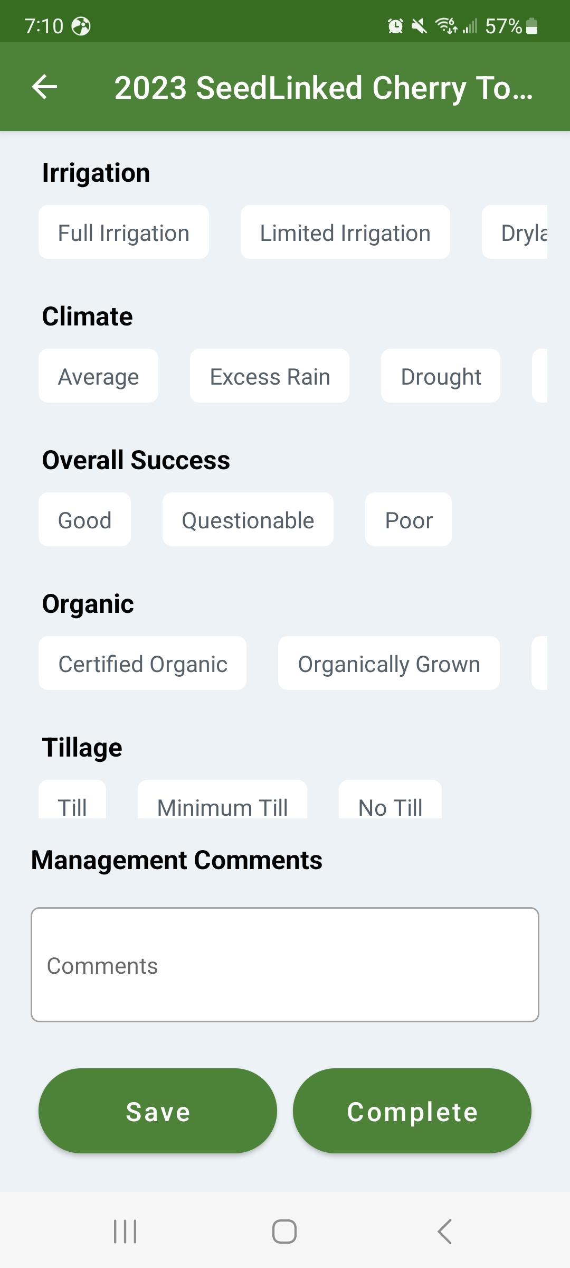
Ask question, share what you see…

Slide 9





What's Inside Each trial box/experience?
3 varieties with planting instructions
Observation tools (mobile app)
Step-by-step participation guide
Feedback portal to share your findings, interact and receive expert advises

Slide 10






Motivation factors
Fun
Guided innovation
Expert knowledge
Unique surprise seed
Simple
>90% satisfaction

Slide 11
2025 Trials in Number to date
4,030 Images
8308 Ratings
4714 Comments
80 data point per accessions
31% participation to date
Posts: >80 posts a week in feed
Participation %: To date from 30 to 40%

Slide 12
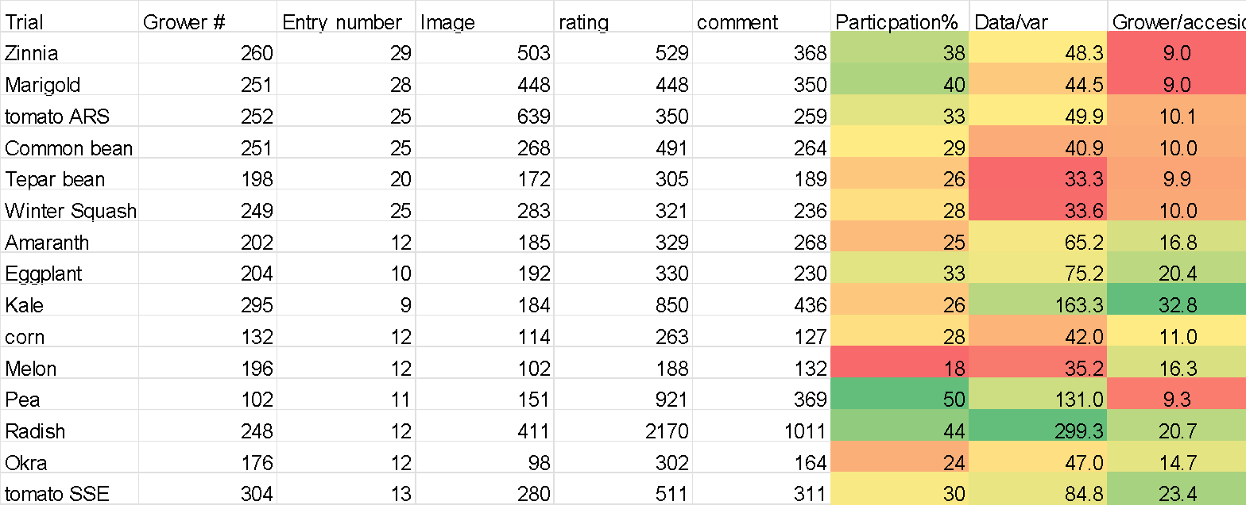
Participation dynamic to date

Slide 13
Trial tour example
Marigold
Kale

Slide 14
Accession example
Kale
Radish
Pea

Slide 15

Posts example
Feed

Slide 16
Future work
What is the optimum number of grower per accessions #?
Refine cost analysis
Improve user interface frictions
GEI modelization
Integrate Genomic
Find more funding

Slide 17
Changing the paradigm from government funded to people funded
Is it a possibility?

Slide 18





Costs – $36/grower (Base on 1500 participants doing around 2.8 trials – 250 accessions)
Shipping: $6
Handling and materials: $5 - $5 seed cost? = $10
Grower recruitment and on boarding: $5
Platform (build, maintenance, run, cloud…): $10
other cost (SARD): $5?

Slide 19
Funding model
Tomorrow- community supported
the innovation box- $40-50
Via Kickstarter or SSE or SeedLinked
30,000 growers by 2030?
>6500 accessions tested
>200,000 plots

Slide 20


Germplasm
Powering the Future of Seeds Through Thousands of seed community scientists

Slide 21



















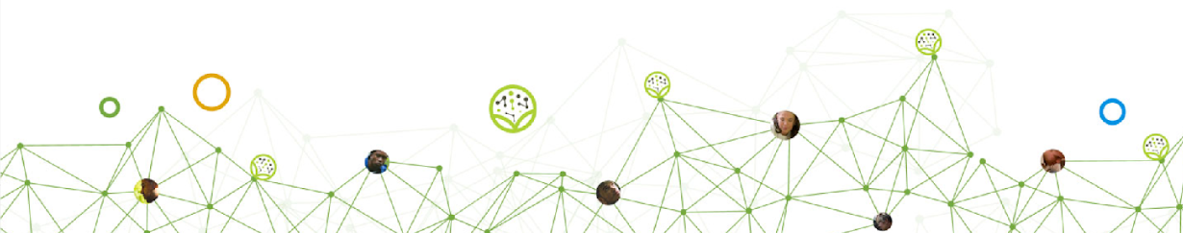



Contact me at:
nico@seedlinked.com
Thanks

