Slide 1
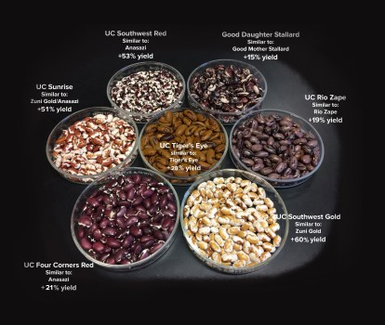
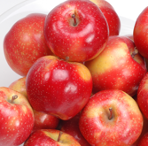
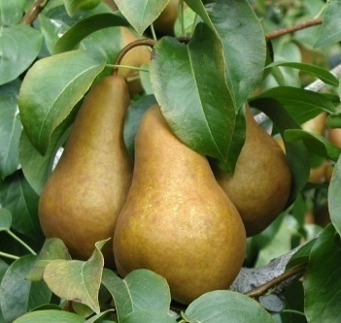
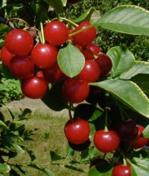
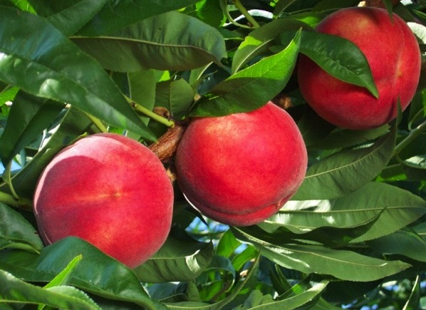
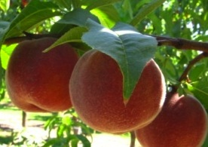
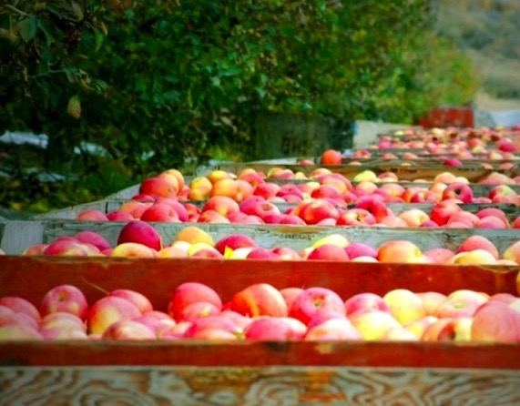
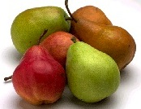
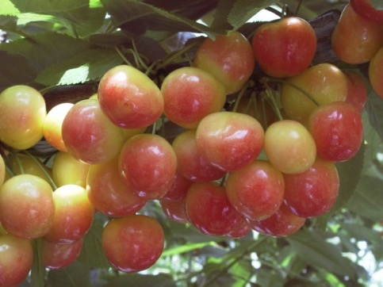
National Genetic Resources Advisory Council (NGRAC) Background and Activities Jim McFerson Organic Seed Alliance 1 Aug 2025
Photo UC-Davis

Slide 2
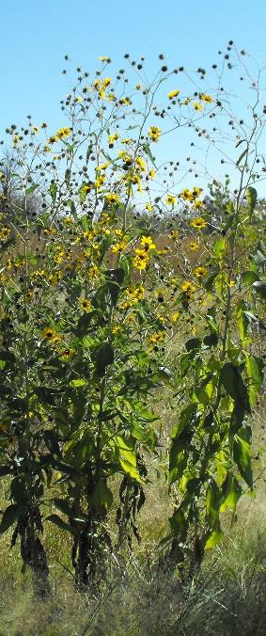
National Genetic Resources Advisory Council
Advise Secretary of Agriculture and Director of National Genetic Resources Program on activities, policies, and operation
Provide advice on acquisition, preservation, access, evaluation, characterization, distribution, and exchange of genetic resources of life forms important to American agriculture: plants, forest species, animals, aquatics, insects, and microbes
Ensure essential resources are adequately conserved and appropriately accessible to address current and future agricultural needs
Provide recommendations on research needs and policy on access and exchange of genetic resources – both international and domestic
Photo by Laura Marek

Slide 3
National Genetic Resources Advisory Council
1990 Established by Food, Agriculture, Conservation & Trade Act via Farm Bill
2002-11 Period of inactivity
2012 Reactivated as a subcommittee of National Agricultural Research, Extension, Education & Economics (NAREEE) Advisory Board
2018-20 Irregular activity (USDA administrative hiatus)
2021-23 Lots pf activity
2024 Irregular activity (lapsed authorization without Farm Bill)
2025 Irregular activity (USDA reorganization)

Slide 4
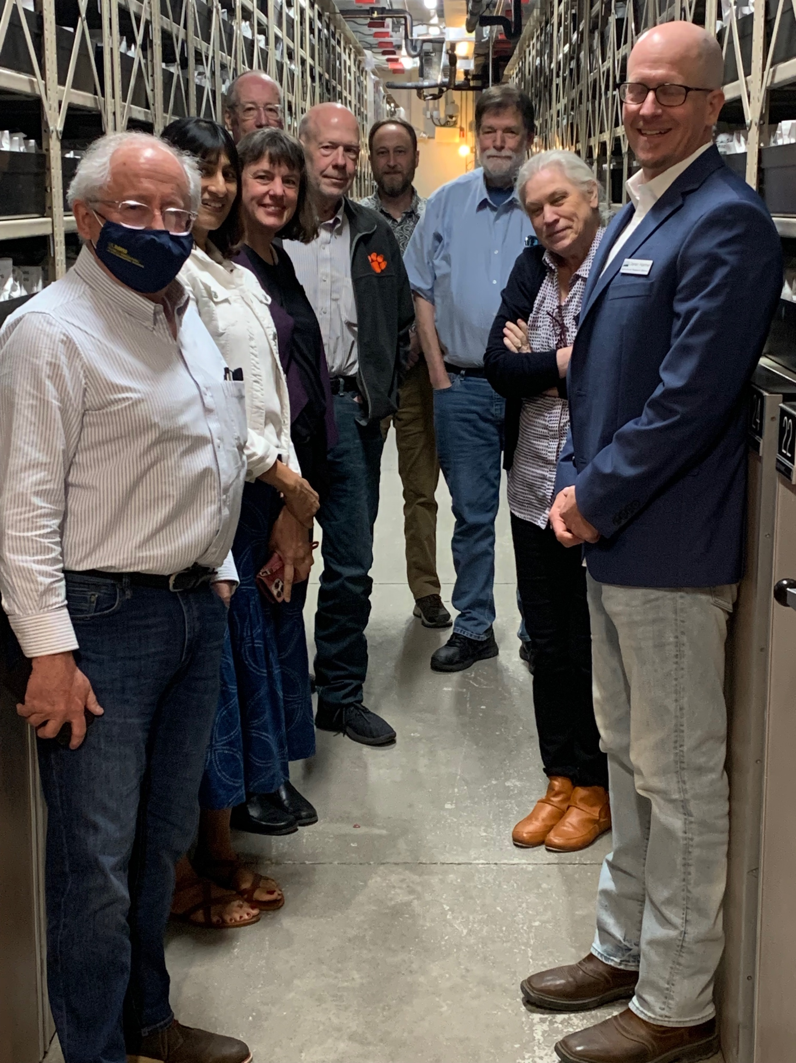
National Genetic Resources Advisory Council
Thirteen members appointed by the Secretary
Seven or more ex-officio members
Membership categories
Six members from scientific community
Three members from the public
Four members from public cultivar development and animal breed development

Slide 5
NGRAC Activities 2015
Report: Access to seed and germplasm for GE-sensitive markets
Evaluation of the pool of commercially available non-genetically engineered and organic seed varieties
Identification of market needs for producers serving GE-sensitive markets
Advice for developing a plan for USDA to work with industry and other stakeholders to ensure a diverse commercial seed supply exists to meet the needs of all farmers

Slide 6
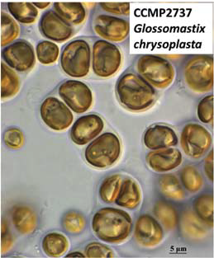
NGRAC Activities 2021-23
Reports Developed and Submitted to NAREEE & Secretary of Ag
Microbial Genetic Resources in the USA
Strengthening Strategic Genetic Resources for
Livestock, Poultry, & Aquatic Species in the USA
Safeguarding and Distributing Native Crop Wild
Relative Genetic Resources of the USA
Algal Genetic Resources: Agricultural Crops and Beyond

Slide 7
NGRAC Reports 2024-25
Reports Developed and Submitted to NAREEE & Secretary of Ag
2018 Farm Bill: Critical Response on National Strategic Germplasm and Cultivar Assessment and Utilization Plan
Towards a More Resilient U.S. Agriculture: Strengthening the NPGS
Expediting Deployment of Genetic Resources
Tribal Engagement with NPGS

Slide 8


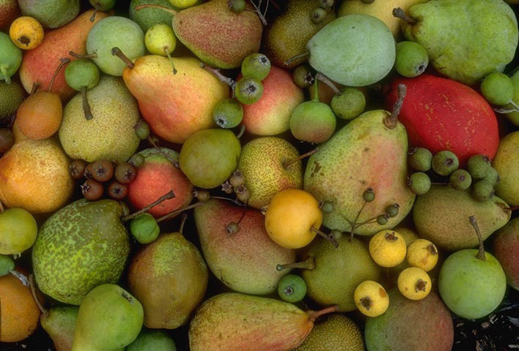
National Genetic Resources Advisory Council (NGRAC) Thanks!
National Agricultural Research, Extension, Education and Economics (NAREEE) Advisory Board

